Slide 1
Mehran S. Fallah
September 20, 2020
Game Theory
Session I
What Is Game Theory?

Slide 2
What Is Game Theory?
(American Heritage) A game is a competitive activity or sport in which players contend with each other according to a set of rules.
Game theory aims to help us understand situations in which decision-makers interact.
Game theory aims to model situations in which multiple participants interact or affect each other’s outcomes.
Game theory takes the rules of the game as given, and makes predictions about the behavior of strategic players who interact in the game
Firms competing for business
Political candidates competing for votes
Jury members deciding on verdict
Animals fighting over prey
Bidders competing in an auction
The role of threats and punishment in long-term relationships
Cooperation in packet forwarding in self-organizing MANETs
Reputation mechanisms in P2P networks

Slide 3
What Is Game Theory?
Game theory is a collection of models.
A model is an abstraction we use to understand our observations and expectations.
The understanding that game-theoretic models give is particularly relevant in the social, political, and economic arenas.
Game theory is not a branch of abstract mathematics; that it is motivated by and related to the world around us; and that it should be able to tell us something about that world.
It should be clear what it is that we are trying to do when we build a game-theoretic model and then apply solution concepts to it.

Slide 4
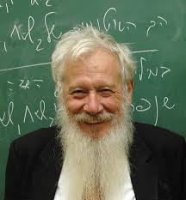
What Are We Trying to Do in Game Theory?
We must first back off a little and ask ourselves what science in general is trying to do.
  Practical Applicability
  Predictive Power
    The theory of relativity was a success, because it predicted the precession of the perihelion of Mercury. If a theory has no predictive power—if it is not ‘‘falsifiable’’—then it is not science.
  Comprehension
    Predictions are an excellent means of testing our comprehension, and once we have the comprehension, applications are inevitable; but the basic aim of scientific activity remains the comprehension itself.

Slide 5
What Are We Trying to Do in Game Theory?
Components of Comprehension: Relationships, Unification, and Simplicity
  relating, associating, recognizing patterns: Snowflakes are hexagonal; in their orbits around the sun, the planets sweep out equal areas in equal times; waves and ripples occur in the ocean as well as on sand dunes; fever is associated with infections
  The law of gravitation is a pattern that one can discern both in the motion of the planets and in the form of a water wave or a sand wave. Crystalline form is observed not only in snow, but in many other materials (unification as kind of relationships.)
  The broader the area that is covered by a theory, the greater is its ‘‘validity.’’
  The idea of gravitation in itself, in the abstract, is rather mysterious; it is important because it enables us to relate the tides to the motion of the planets and to the trajectories of shells and missiles.
  Simplicity as opposite of complexity and difficulty
    Spareness in exogenous parameters: as few as possible exogenous parameters should be used: In Newton’s theory, one needs just two parameters (mass and velocity) to describe the motion of a body
    Spareness in the basic structure of the theory: can be derived from his three basic laws of motion plus the inverse square law of gravitation, all of which are very simple.
    For a theory to be useful, working with it must be practical (not difficult.)

Slide 6
What Are We Trying to Do in Game Theory?
In constructing a scientific theory, we are not trying to get at the truth, or even to approximate to it: rather, we are trying to organize our thoughts and observations in a useful manner.
scientific theories must be judged by how well they enable us to organize and understand our observations; by how well they ‘‘work.’’
As our observations increase in volume and change in character, old scientific theories are no longer as appropriate as before; they either evolve and change, or are replaced by entirely new and different theories.
We discard a theory not because it has been ‘‘disproved,’’ but because it no longer works, is no longer appropriate.
It is even possible for two competing theories to exist happily side by side and be used simultaneously; relativistic vs Newtonian mechanics, and wave vs particle theories of light

Slide 7
Descriptive Game Theory
Game and economic theory are concerned with the interactive behavior of Homo rationalis—rational man.
Homo rationalis is the species that always acts both purposefully and logically, has well-defined goals, is motivated solely by the desire to approach these goals as closely as possible, and has the calculating ability required to do so.
Homo rationalis is a mythical species, like the unicorn and the mermaid.
Homo sapiens, is often guided by subconscious psychological drives, or even by conscious ones, that are totally irrational
Thus we cannot expect game and economic theory to be descriptive in the same sense that physics or astronomy are.
We do gain some insight into the behavior of Homo sapiens by studying Homo rationalis
While in any given situation an individual may well act irrationally, there seems to be a cumulative effect of time and learning that pushes people ‘‘in general’’ in the direction of rational decision-making.
Homo rationalis can serve as a model for certain aspects of the behavior of Homo sapiens.
We can expect our theory only sometimes to explain or provide insights into ‘‘real’’ phenomena. We do not yet know how to integrate rational sciences like game theory and economics with non-rational sciences like psychology and sociology to yield accurate predictions.

Slide 8
Normative (Prescriptive) Game Theory
Game theory as engineering rather than as science
Solution concepts will often have both descriptive and normative interpretations.
When we come to advise people, it is clear that we should give them rational, utility-maximizing advice, i.e., precisely what Homo rationalis would do; so that the descriptive and normative aspects are in this sense quite close.
Normative aspects of game theory may be subclassified using various dimensions:
  Whether we are advising a single player on how to act best in order to maximize payoff to himself, if necessary at the expense of the other players; and the other is advising society as a whole (or a group of players) of reasonable ways of dividing payoff among themselves.
  Another distinction is between advice that is precise and/or numerical, and normative insights of a general nature.
    a specific minimax strategy
    in negotiating an international treaty, each side should make sure that the proposed treaty represents an equilibrium point

Slide 9
Classifying Function of Game Theory
Game theory classifies interactive decision situations.
A classification of game situations is in fact as important for the normative as for the descriptive theory.
Classification is indispensable to enable us to organize our thoughts.
Games can be classified into cooperative or non-cooperative according to whether or not there is available a mechanism that can enforce agreements.
Games of complete and incomplete information
  The early development of game theory treated only complete information games, i.e., those in which the structure of the game and the payoffs are common knowledge to the players.
  Harsanyi’s work led to a stream of investigations of incomplete information models of ever-increasing volume and depth; today, incomplete information is perhaps the ‘‘hottest’’ topic in economic theory.
    A new insight: Disagreement is a perfectly rational outcome in incomplete information cooperative bargaining.

Slide 10
Classifying Function of Game Theory
Game theory classifies interactive decision situations.
A classification of game situations is in fact as important for the normative as for the descriptive theory.
Classification is indispensable to enable us to organize our thoughts.
Games can be classified into cooperative or non-cooperative according to whether or not there is available a mechanism that can enforce agreements.
Games of complete and incomplete information
  The early development of game theory treated only complete information games, i.e., those in which the structure of the game and the payoffs are common knowledge to the players.
  Harsanyi’s work led to a stream of investigations of incomplete information models of ever-increasing volume and depth; today, incomplete information is perhaps the ‘‘hottest’’ topic in economic theory.
    A new insight: Disagreement is a perfectly rational outcome in incomplete information cooperative bargaining.

Slide 11
Game-Theoretic Modeling
Game-theoretic modeling starts with an idea related to some aspect of the interaction of decision-makers.
We express this idea precisely in a model, incorporating features of the situation that appear to be relevant. This step is an art.
  One should put enough ingredients into the model to obtain nontrivial insights.
The next step is to analyze the model—to discover its implications (note that the model entails a solution concept.)
Our analysis may yield results that confirm our idea, or that suggest it is wrong. If it is wrong, the analysis should help us to understand why it is wrong. We may see that an assumption is inappropriate, or that an important element is missing from the model; we may conclude that our idea is invalid, or that we need to investigate it further by studying a different model.
Thus, the interaction between our ideas and models designed to shed light on them runs in two directions: the implications of models help us determine whether our ideas make sense, and these ideas, in the light of the implications of the models, may show us how the assumptions of our models are inappropriate.
In either case, the process of formulating and analyzing a model should improve our understanding of the situation we are considering.

Slide 12

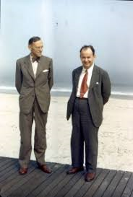
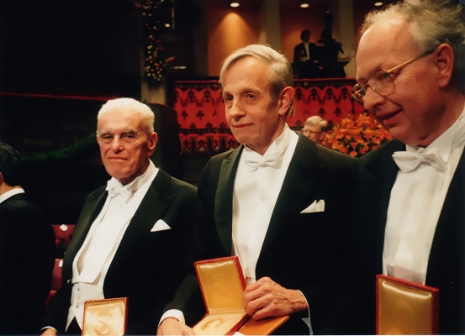
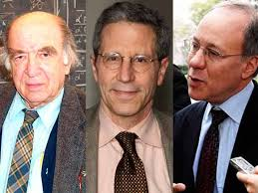
History of Game Theory
Papers by Cournot (1838), Bertrand (1883) and Edgeworth (1925) on oligopoly pricing and production.
John von Neumann and Oskar Morgenstern (1944) in the book “Theory of games and economic behavior”
The use of game theory in studying evolutionary biology (Mynard Smith).
The 1994 Nobel prize in economics was awarded to game theorists John Harsanyi, John Nash, and Richard Selten.
The 2007 Nobel prize was awarded to game theorists Hurwicz, Maskin, and Myerson.
Apart from the work on the core theory, many researches are on the employment of the theory in contemporary applications.

Slide 13
The Theory of Rational Choice
The theory of rational choice is a component of many models in game theory. The theory is based on a model with two components: the set of actions available to the decision-maker, and a specification of the decision-maker’s preferences.
A decision-maker chooses the best action according to her preferences, among all the actions available to her.
Rationality lies in the consistency of the decision-maker’s decisions when faced with different sets of available actions, not in the nature of her likes and dislikes.
When presented with any pair of actions, the decision-maker knows which of the pair she prefers, or knows that she is “indifferent between the actions”. These preferences are consistent in the sense that if the decision-maker prefers a to b, and b to c, then she prefers the action a to the action c.
How can we describe a decision-maker’s preferences?
  A relation on the set of actions specifying the action the decision-maker prefers.
  A “payoff function” (also said “utility function” or “preference indicator function”) representing preferences by assigning a number to each action.
      u(a) > u(b) if and only if the decision-maker prefers a to b.

Slide 14
The Theory of Rational Choice
A person is faced with the choice of three vacation packages, to Havana, Paris, and Venice, for example. She prefers the package to Havana to the other two, which she regards as equivalent. We can set
      u(Havana) = 1 and u(Paris) = u(Venice) =0, or
      u(Havana) = 10 and u(Paris) = u(Venice) = 1, or
      u(Havana) = 0 and u(Paris) = u(Venice) = −2.
As another example, consider altruistic preferences. Person 1 cares both about her income and about person 2’s income. Precisely, the value she attaches to each unit of her own income is the same as the value she attaches to any two units of person 2’s income. Her preferences order the outcomes (1, 4), (2, 1), and (3, 0) as follows, where the first component in each case is person 1’s income and the second component is person 2’s income.
                (2, 1) < (1, 4), (2, 1) < (3, 0), (1, 4) = (3, 0).
  One of the payoff functions consistent with theses preferences is u(x, y)=x + y/2, where x and y are person 1’s and person2’s incomes, respectively.
if u represents a decision-maker’s preferences and v is another payoff function for which
                v(a) > v(b) if and only if u(a) > u(b),
  then v also represents the decision-maker’s preferences.

Slide 15
The Theory of Rational Choice
Allowing for the possibility that there are several equally attractive best actions, the theory of rational choice is:
    the action chosen by a decision-maker is at least as good, according to her preferences, as every other available action.
If we have no information about a decision-maker’s preferences, and make no assumptions about their character, any single action is consistent with the theory.
However, if we assume that a decision-maker who is indifferent between two actions sometimes chooses one action and sometimes the other, not every collection of choices for different sets of available actions is consistent with the theory.
  A decision-maker chooses a whenever she faces the set {a, b}, but sometimes chooses b when facing the set {a, b, c}. The fact that she always chooses a when faced with {a, b} means that she prefers a to b (if she were indifferent then she would sometimes choose b). But then when she faces the set {a, b, c} she must choose either a or c, never b. Thus her choices are inconsistent with the theory.

Slide 16
Some Important Topics
Static games of complete information, games in normal form, and solution concepts: iterated deletion of dominated strategies, rationalizability, Nash equilibrium, correlated equilibrium, and so on
Dynamic games of complete information, games in extensive form, and solution concepts: backward induction and subgame perfection
Static games of incomplete information and Bayesian equilibrium
Dynamic games of incomplete information and solution concepts: perfect Bayesian equilibrium and sequential equilibrium
Mechanism design
Cooperative game theory, coalitions, bargaining, and solution concepts: core and Shapley value
Evolutionary game theory
Stochastic games
Algorithmic game theory

Slide 17
Some Resources
Fudenberg, D., and Tirole, J. (1991). Game Theory, Cambridge, MA: MIT Press.
Hurwicz, L., and Reiter, S. (2006). Designing Economic Mechanisms, Cambridge: Cambridge University Press.
Maynard Smith, J. (1982). Evolution and the Theory of Games, Cambridge: Cambridge University Press.
Nash, J. (1950a). ‘Equilibrium Points in n-Person Games.’ Proceedings of the National Academy of Science, 36: 48–49.
––– (1950b). ‘The Bargaining Problem.’ Econometrica, 18: 155–162.
––– (1951). ‘Non-cooperative Games.’ Annals of Mathematics Journal, 54: 286–295.
––– (1953). Two-Person Cooperative Games. Econometrica, 21: 128–140.
Samuelson, L. (1997). Evolutionary Games and Equilibrium Selection, Cambridge, MA: MIT Press.
Stirling, W. (2012). Theory of Conditional Games, Cambridge: Cambridge University Press.
von Neumann, J., and Morgenstern, O., (1947). The Theory of Games and Economic Behavior, second edition, Princeton: Princeton University Press.
Weibull, J. (1995). Evolutionary Game Theory, Cambridge, MA: MIT Press.
Nisan, N. et al., (2007). Algorithmic Game Theory, Cambridge University Press.

Slide 18
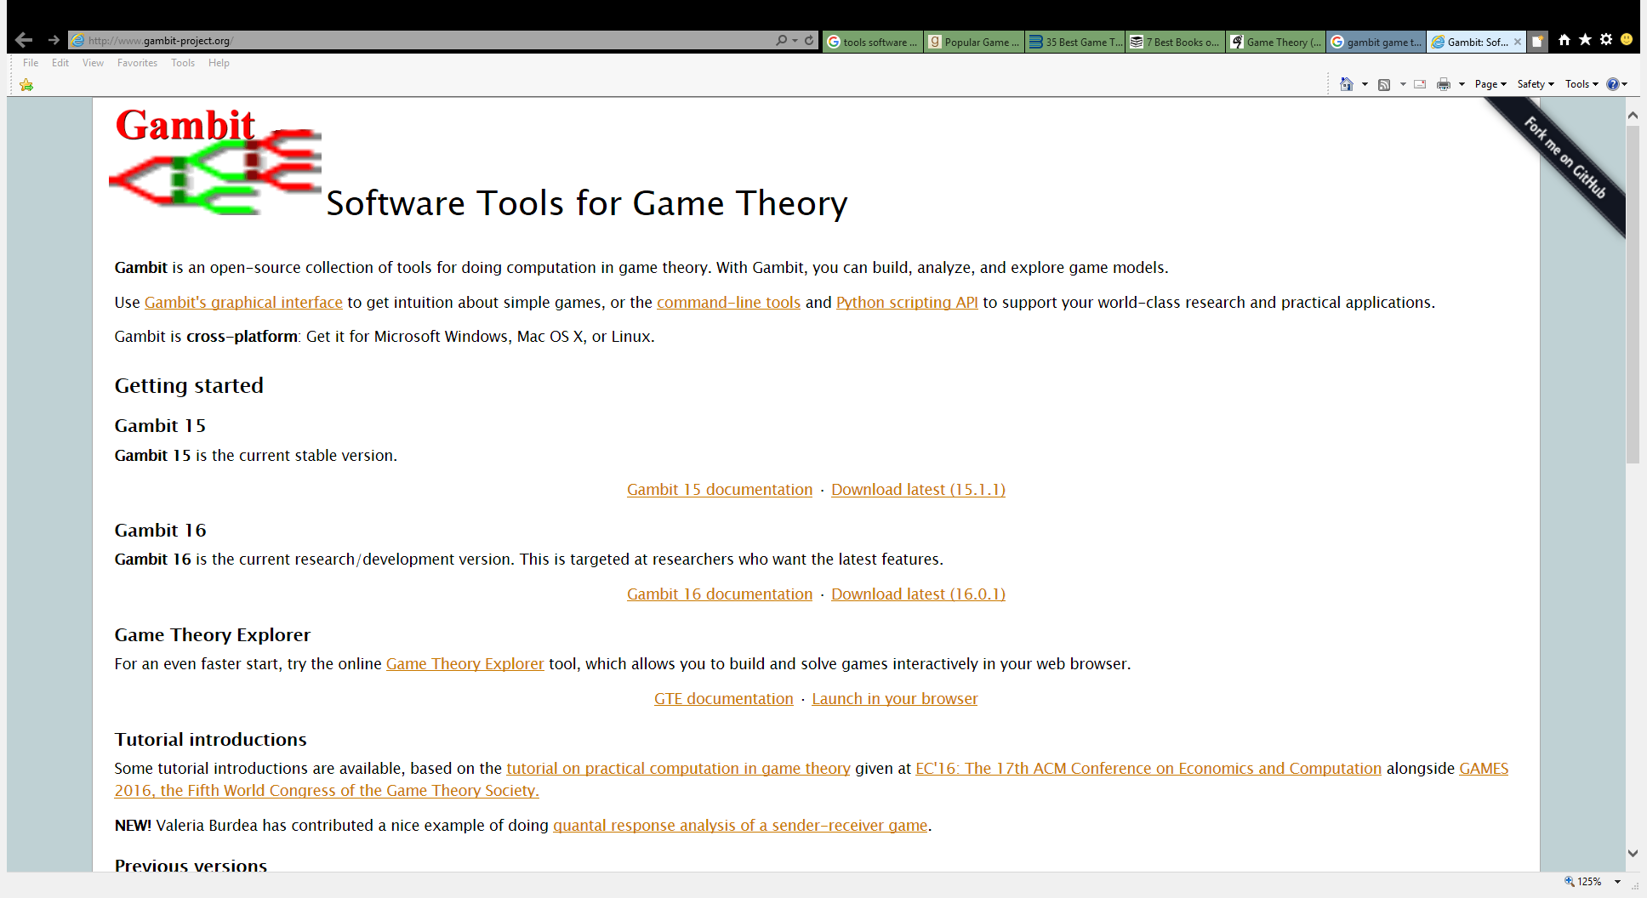
Software Tools

Slide 19
Any Question?

